Slide 1
https://www.springboard.com/blog/data-wrangling/

Slide 2
1. Data wrangling is the process of cleaning and unifying messy and complex data sets for easy access and analysis.
2. Data Wrangling acts as a preparation stage for the Data mining operation.
3. Data wrangling refers to the process of cleaning, restructuring and enriching the raw data available into a more usable format. This will help the scientist quicken
the process of decision making, and thus get better insights in less time.
4. Data wrangling, sometimes referred to as data munging, is the process of transforming and mapping data from one "raw" data form into another format with the
intent of making it more appropriate and valuable for a variety of downstream purposes such as analytics.
5. Pandas is one of the most popular Python library for data wrangling.
The goals of data wrangling:
1. Reveal a “deeper intelligence” within your data, by gathering data from multiple sources
2. Provide accurate, actionable data in the hands of business analysts in a timely matter
3. Reduce the time spent collecting and organizing unruly data before it can be utilized
4. Enable data scientists and analysts to focus on the analysis of data, rather than the wrangling
5. Drive better decision-making skills by senior leaders in an organization

Slide 3
Data Wrangling Steps or process:
1. Preprocessing — the initial state that occurs right after the acquiring of data (Getting data from the various source into one place).
2. Standardizing data into an understandable format. For ex: you have user profile events record, and you need to sort it by types of events and time stamps;
3. Cleaning data from noise, missing or erroneous elements.
4. Consolidating data from various sources or data sets into a coherent whole. For example, you have an affiliate advertising network, and you need to gather
performance statistics for the current stage of the marketing campaign;
5. Matching data with the existing data sets. For example, you already have user data for a certain period and unite these sets into a more expansive one;
Filtering data through determined settings for the processing.
The key steps to data wrangling:
1. Data Acquisition: Identify and obtain access to the data within your sources
2. Joining Data : Combine the edited data for further use and analysis
3. Data Cleansing: Redesign the data into a usable/functional format and correct/remove any bad data

Slide 4
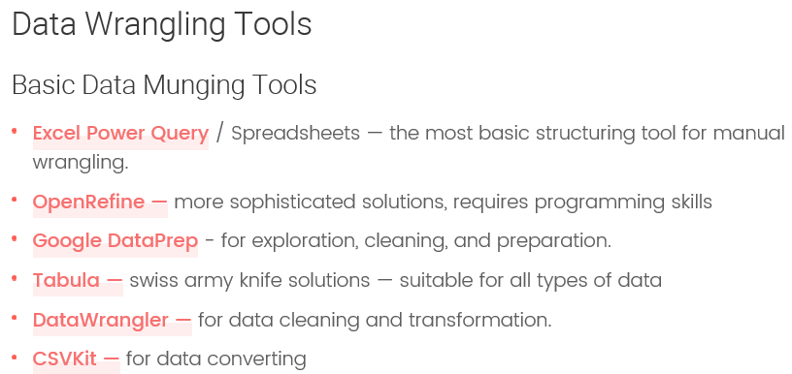
Data Wrangling Machine Learning Algorithms :
Overall, there are the following types of machine learning algorithms at play:
1. Supervised ML algorithms are used for standardizing and consolidating disparate data sources:
i. Classification is used to identify known patterns;
ii. Normalization is used to flatten the independent variables of data sets and restructure data into a more cohesive form.
2. Unsupervised ML algorithms are used for exploration of unlabeled data:
i. Clustering is used to detect distinct patterns

Slide 5
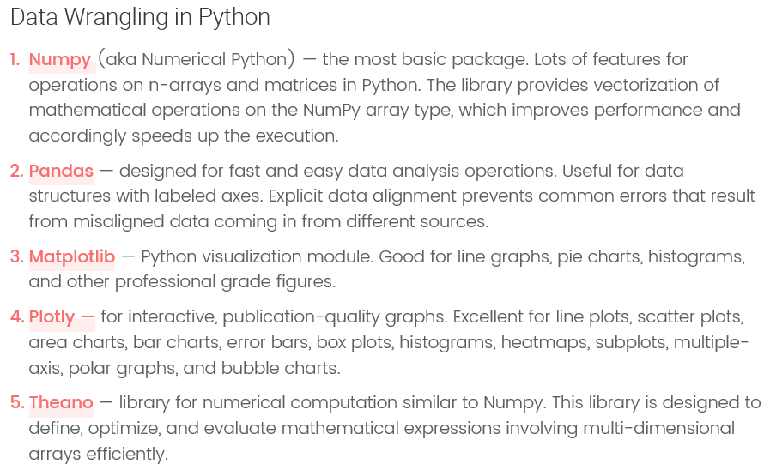
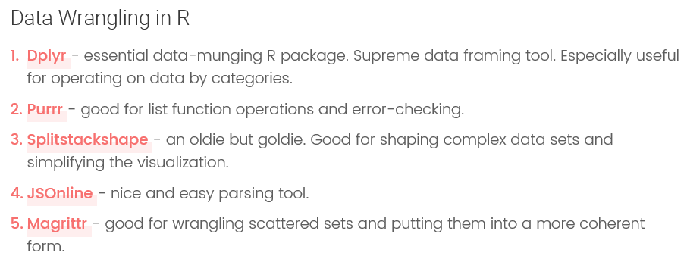

Slide 6
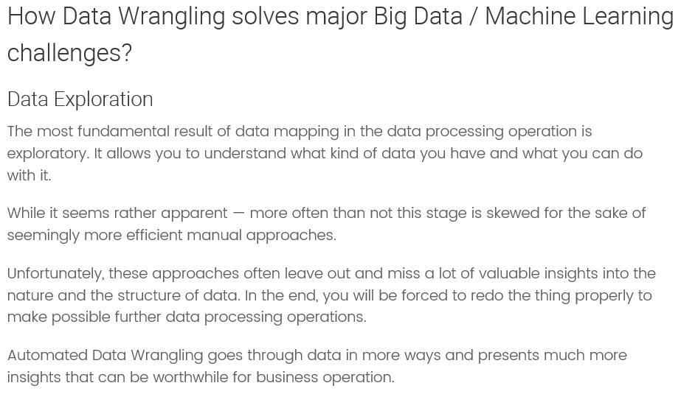
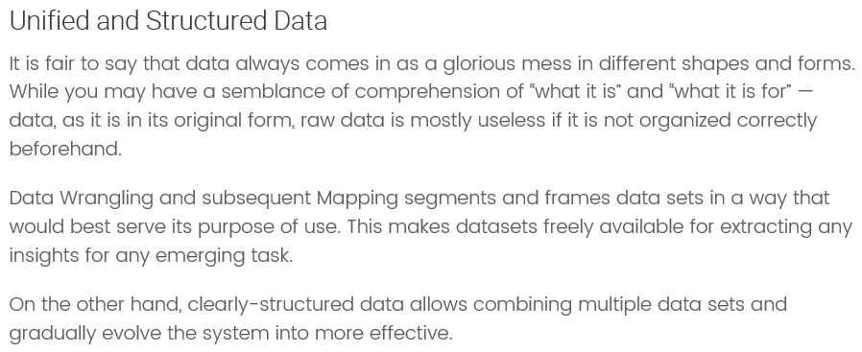

Slide 7
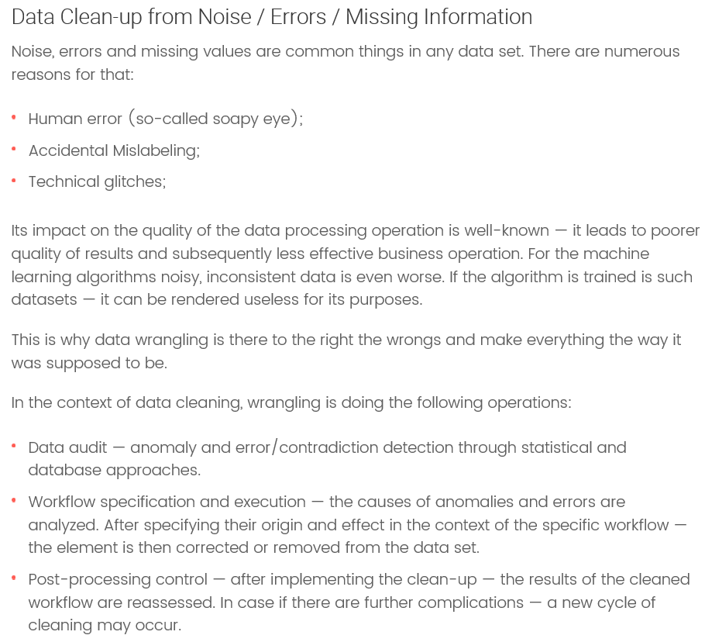

Slide 8
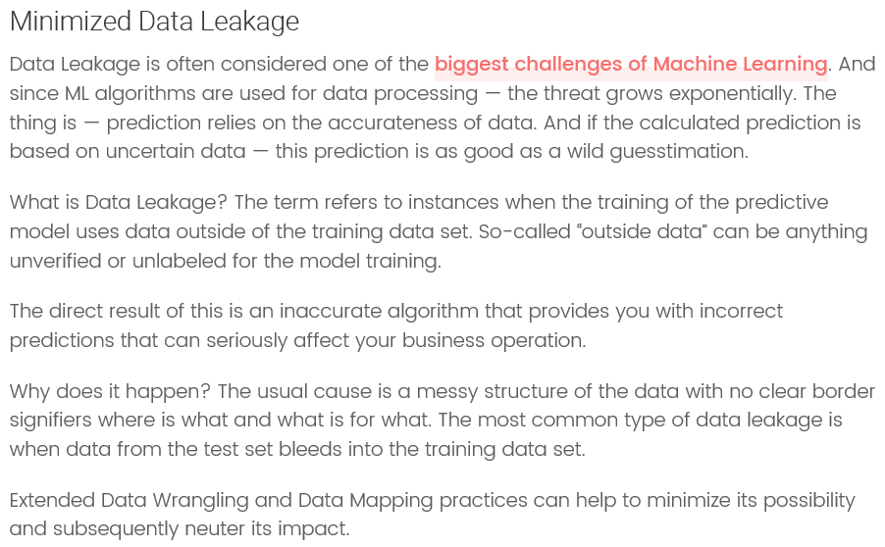

Slide 9
Data wrangling
Data Sorting: To rearrange values in ascending or descending order.
Data Filtration: To create a subset of available data.
Data Reduction: To eliminate or replace unwanted values.
Data Access: To read or write data files.
Data Processing: To perform aggregation, statistical, and similar operations on specific values.
The following pandas functionalities will be covered:
1. Data exploration — columns, unique values in a column, describe, duplicates
2. Dealing with missing values — quantifying missing values per column, filling & dropping missing values
3. Reshaping data — one hot encoding, pivot tables, joins, grouping and aggregating
4. Filtering data
5. Other — Making descriptive columns, element-wise conditional operations

Slide 10
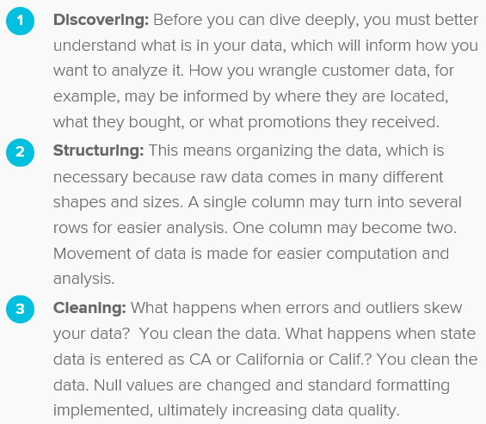
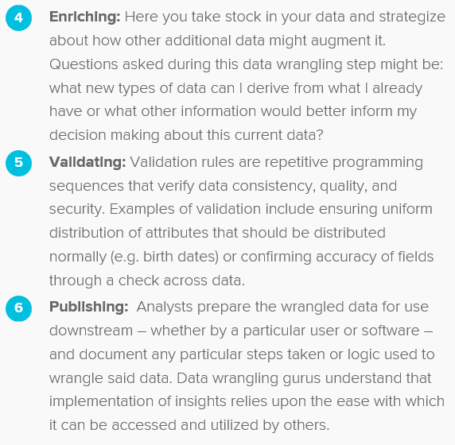
Data wrangling is the process of cleaning, structuring and enriching raw data into a desired format for better decision making in less time.

